Slide 1

Lifting the Fog of War
Monitoring, Identifying and Mitigating MS-RPC Based Threats

Slide 2


whoami
Stiv Kupchik
Security Researcher
Akamai
@kupsul
Background in DFIR and Windows internals
Notes:
I’m Stiv, I’m a security researcher here at Akamai
I started out at the threat hunting team, Hunt, and then moved on to our research team. Over the past year and a half or so, we focused on MS-RPC, and even presented at last year’s Defcon and Hexacon. This talk is a continuation of our research.

Slide 3
Agenda
MS-RPC introduction and overview
ETW introduction and overview
Using ETW to detect MS-RPC based attacks
Supplementing defense with RPC Filters
Notes:
Today, we’ll talk about these topics. We’ll (re)introduce MS-RPC, but we’ll look at it from the defensive side.
We’ll see how we can use ETW to detect attacks that are carried over RPC, and I’ll also show my tool that helps with the consumption and analysis of ETW events.
We’ll also demonstrate how we can use other built-in tools, like RPC Filters in the Windows Firewall, to help mitigate the risk based on what we’re seeing.
Throughout this talk I’ll use RPC and MS-RPC interchangeably! It will always refer to Microsoft’s implementation.

Slide 4
#define RPC
Notes:
RPC stands for remote procedure call. It’s a sort of IPC protocol to allow programs to expose their capabilities. In this talk we’ll focus on MS-RPC, Microsoft’s implementation of RPC that’s been around since the 90’s

Slide 5
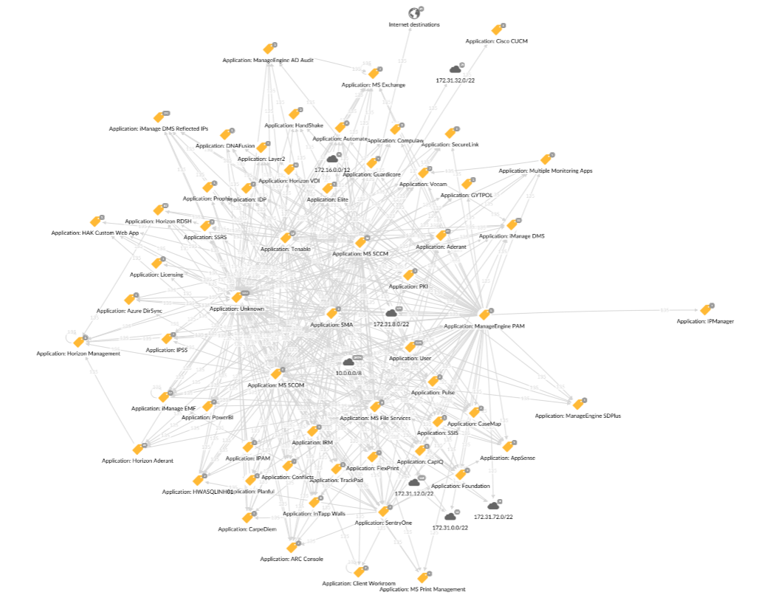
It’s everywhere in the network
Notes:
That’s because it’s everywhere. This is an image of a (real life) network, filtered to show only traffic on a certain RPC port (that we will touch later).
You can tell just by looking at this map, that RPC is extremely in-use.

Slide 6
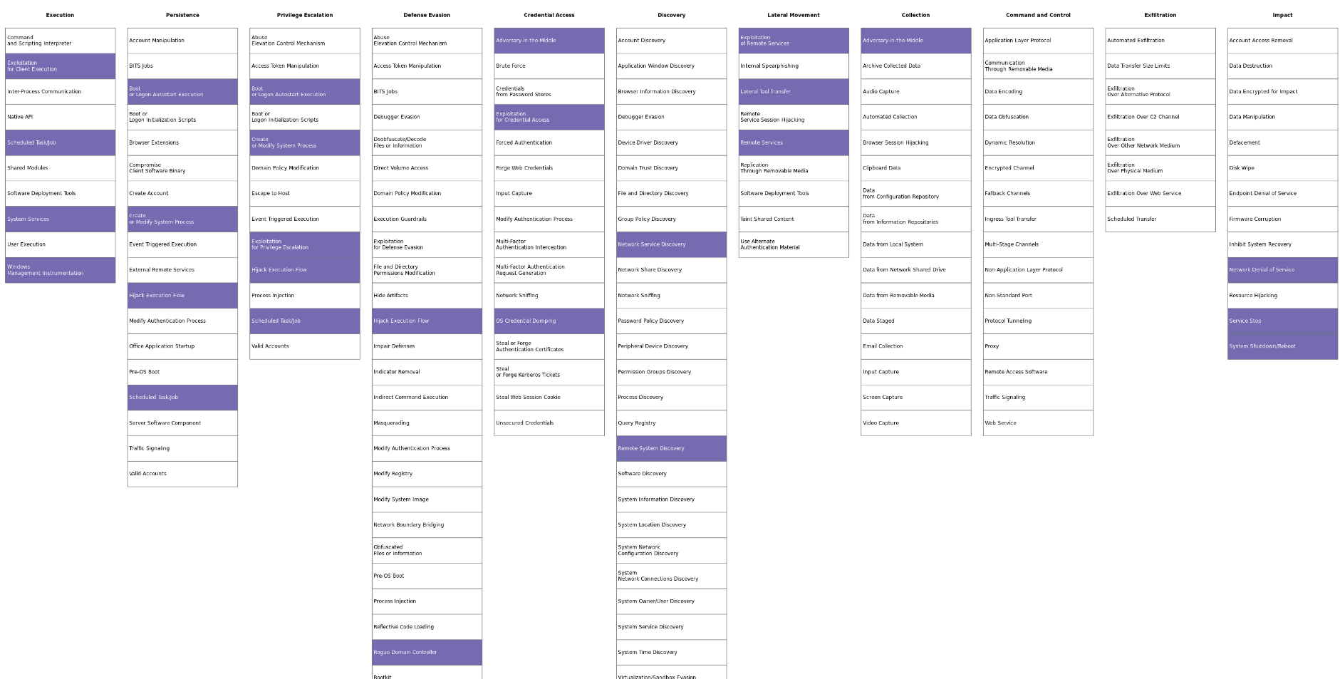
… and is involved in many parts of the attack matrix
Notes:
It is also an important tool for network attacks, and lateral movement specifically.
PSExec, DCSync, task scheduler, WMI are all lateral movement techniques that rely on RPC.
It is also the underlying protocol for other network based vulnerabilities, like PetitePotam or Zerologon, not to mention other vulnerabilities our team found in the mechanism itself.

Slide 7
RPC Attacks are Hard to Detect
RPC is another layer of encapsulation that you need to peel
Deep packet inspection is expensive, usually only connection metadata

Slide 8
RPC Attacks are Hard to Detect
RPC is another layer of encapsulation that you need to peel
Deep packet inspection is expensive, usually only connection metadata
Most RPC servers are running under svchost or protected processes
Difficult to match traffic to process or RPC server

Slide 9
RPC Attacks are Hard to Detect
RPC is another layer of encapsulation that you need to peel
Deep packet inspection is expensive, usually only connection metadata
Most RPC servers are running under svchost or protected processes
Difficult to match traffic to process or RPC server
RPC traffic can occur over ephemeral ports or SMB
Can’t create FW rules in advance

Slide 10
Not Many (documented) Defense Options
RPC Filters in the Windows Firewall
ETW monitors aimed at researchers
RpcMon by CyberArk
RpcInvestigator by TrailOfBits
RPC Firewall by ZeroNetworks
requires process injection & hooks
Notes:
Yet there aren’t that many defensive mechanisms that can accurately target RPC. There’s the RPC Filters built into the Windows Firewall, but they’re aren’t well documented.
There’s also some research, blogpost and tools regarding ETW and RPC, similarly to this talk. They’re mostly aimed at researchers though, and look at what is happening on a local machine with less focus on the network aspect.
The most defensive tool is probably RPC Firewalls, which was created by ZeroNetworks and introduced at BlackHat Europe in 2021 by Sagie Dulce. But that’s a 3rd party tool that requires process injections.
In this talk, we’ll discuss how to extract the most out of the built in capabilities in Windows, which are ETW and RPC Filters.

Slide 11
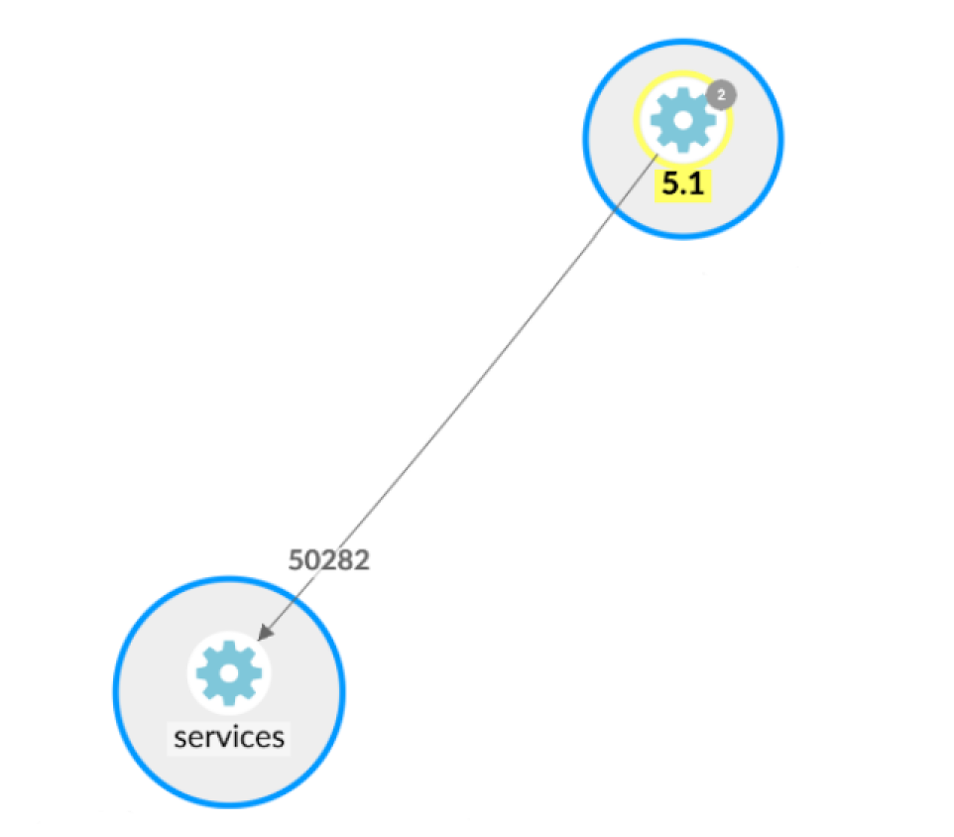
RPC without visibility

Slide 12
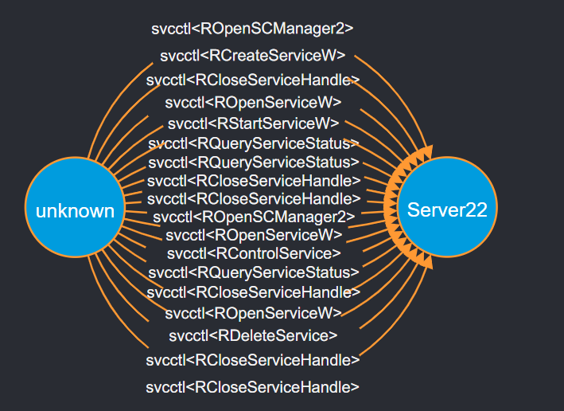
RPC with visibility

Slide 13
MS-RPC Overview
Notes:
Let’s start with a quick RPC overview.

Slide 14
Terminology you’ll soon master
Interface
{M}IDL
Transport
Endpoint
Binding
Notes:
After this section, if we do our job well, you’ll understand what every term on this slide means and how they relate to each other.

Slide 15
The RPC Client-Server Model
Server
Client
Notes:
RPC relies on a client-server model, [c] where the client wishes to invoke some functionality on the server side.
In order to have a common ground, the client and server agree upon an [c] interface.
The interface is specified in a file called IDL (stands for Interface Definition Language) and lists which functions the server exposes and their signature. Every interface has a name and a unique identifier in the form of UUID.
In order to refer to this interface and its functions, the client and server need header and source files, [c] which are produced by MIDL – Microsoft IDL compiler.
But how does the client know who to talk to in terms of network? →

Slide 16
The RPC Client-Server Model
Server
Foo(5, “Hello”)
Client
Notes:
RPC relies on a client-server model, [c] where the client wishes to invoke some functionality on the server side.
In order to have a common ground, the client and server agree upon an [c] interface.
The interface is specified in a file called IDL (stands for Interface Definition Language) and lists which functions the server exposes and their signature. Every interface has a name and a unique identifier in the form of UUID.
In order to refer to this interface and its functions, the client and server need header and source files, [c] which are produced by MIDL – Microsoft IDL compiler.
But how does the client know who to talk to in terms of network? →

Slide 17
The RPC Client-Server Model
Server
[ uuid(12345678-4000-2006-0000-20000000001a)
]
interface Test
{
void Foo([in] int number, [in] char *message);
void Bar([out] int * result);
}
Foo(5, “Hello”)
Client
Notes:
RPC relies on a client-server model, [c] where the client wishes to invoke some functionality on the server side.
In order to have a common ground, the client and server agree upon an [c] interface.
The interface is specified in a file called IDL (stands for Interface Definition Language) and lists which functions the server exposes and their signature. Every interface has a name and a unique identifier in the form of UUID.
In order to refer to this interface and its functions, the client and server need header and source files, [c] which are produced by MIDL – Microsoft IDL compiler.
But how does the client know who to talk to in terms of network? →

Slide 18
The RPC Client-Server Model
Server
[ uuid(12345678-4000-2006-0000-20000000001a)
]
interface Test
{
void Foo([in] int number, [in] char *message);
void Bar([out] int * result);
}
Test_s.c
Test.h
MIDL.exe
Foo(5, “Hello”)
Test_c.c
Client
Notes:
RPC relies on a client-server model, [c] where the client wishes to invoke some functionality on the server side.
In order to have a common ground, the client and server agree upon an [c] interface.
The interface is specified in a file called IDL (stands for Interface Definition Language) and lists which functions the server exposes and their signature. Every interface has a name and a unique identifier in the form of UUID.
In order to refer to this interface and its functions, the client and server need header and source files, [c] which are produced by MIDL – Microsoft IDL compiler.
But how does the client know who to talk to in terms of network? →

Slide 19
The RPC Client-Server Model
Server
[ uuid(12345678-4000-2006-0000-20000000001a)
]
interface Test
{
void Foo([in] int number, [in] char *message);
void Bar([out] int * result);
}
Test_s.c
Test.h
MIDL.exe
Foo(5, “Hello”)
Test_c.c
Client
Notes:
RPC relies on a client-server model, [c] where the client wishes to invoke some functionality on the server side.
In order to have a common ground, the client and server agree upon an [c] interface.
The interface is specified in a file called IDL (stands for Interface Definition Language) and lists which functions the server exposes and their signature. Every interface has a name and a unique identifier in the form of UUID.
In order to refer to this interface and its functions, the client and server need header and source files, [c] which are produced by MIDL – Microsoft IDL compiler.
But how does the client know who to talk to in terms of network? →

Slide 20
Endpoints
The server registers an endpoint using a certain transport
Transports | Protocol Sequence | Endpoints
TCP Named pipe UDP ALPC HTTP Hyper-V socket | ncacn_ip_tcp ncacn_np ncadg_ip_udp ncalrpc ncacn_http ncacn_hvsocket | <port number> <pipe name> <port number> <ALPC port> <hostname> <UUID>
Notes:
For this purpose RPC has the notion of endpoints.
Every server need to register an endpoint over a certain transport. Transports can be many things, TCP, UDP, etc., and the endpoint is a certain destination over this transport, a certain port, a hostname or a pipe name.
The relation between and interface and an endpoint is not 1-to-1: there can even be one endpoint exposing several interfaces, or several endpoints exposing a single interface.

Slide 21
Well-Known Endpoints
Dynamic Endpoints
Server
Foo(5, “Hello”)
[TCP port 39776]
Client
Notes:
With such a dedicated, or “well known” endpoint, the client knows in advance exactly what endpoint to request, and this port or pipe is either hardcoded into the client or specific in the interface IDL file.
With dynamic endpoints, the client asks an intermediary named the Endpoint Mapper for the server’s endpoint. The EPMapper has its own port, 135, which the client queries whenever they need to know which endpoint to connect to.

Slide 22
Well-Known Endpoints
Dynamic Endpoints
Server
EP Mapper
Server
Hi I need server <UUID>
[TCP port 135]
Foo(5, “Hello”)
[TCP port 39776]
Client
Client
Notes:
With such a dedicated, or “well known” endpoint, the client knows in advance exactly what endpoint to request, and this port or pipe is either hardcoded into the client or specific in the interface IDL file.
With dynamic endpoints, the client asks an intermediary named the Endpoint Mapper for the server’s endpoint. The EPMapper has its own port, 135, which the client queries whenever they need to know which endpoint to connect to.

Slide 23
Well-Known Endpoints
Dynamic Endpoints
Server
EP Mapper
Server
Ok talk to TCP port 50501
Hi I need server <UUID>
[TCP port 135]
Foo(5, “Hello”)
[TCP port 39776]
Client
Client
Notes:
With such a dedicated, or “well known” endpoint, the client knows in advance exactly what endpoint to request, and this port or pipe is either hardcoded into the client or specific in the interface IDL file.
With dynamic endpoints, the client asks an intermediary named the Endpoint Mapper for the server’s endpoint. The EPMapper has its own port, 135, which the client queries whenever they need to know which endpoint to connect to.

Slide 24
Well-Known Endpoints
Dynamic Endpoints
Server
EP Mapper
Server
Ok talk to TCP port 50501
Hi I need server <UUID>
[TCP port 135]
Foo(5, “Hello”)
[TCP port 39776]
Foo(5, “Hello”)
[TCP port 50501]
Client
Client
Notes:
With such a dedicated, or “well known” endpoint, the client knows in advance exactly what endpoint to request, and this port or pipe is either hardcoded into the client or specific in the interface IDL file.
With dynamic endpoints, the client asks an intermediary named the Endpoint Mapper for the server’s endpoint. The EPMapper has its own port, 135, which the client queries whenever they need to know which endpoint to connect to.

Slide 25
Binding
The representation of a session between a client and a server
Practically, a handle
Client and server can manipulate binding data using designated functions
Used for authentication (among other things)
Notes:
There are several types of binding (automatic, implicit and explicit) but we will not go into this for the scope of the talk.
When the client sets authentication on the binding, the binding is considered authenticated.
https://docs.microsoft.com/en-us/windows/win32/rpc/binding-handles

Slide 26
An RPC Call’s Flow
Client
Server
Foo(5, “hello”)
Notes:
Now let’s see how an RPC call is processed.
The client first invokes the function they know is exposed by the interface.
This function calls an [c] RPC runtime function – NdrClientCall, which in turn triggers many operations in the RPC runtime: [c] marshalling the function parameters, connecting to the endpoint over the network (or not), binding, which is sort-of handshaking with the server and authenticating to it.
The RPC runtime is also compiled into the [c] server application, where is listens to incoming connections, performs access checks and unmarshalls the data sent over the network.
Eventually, the call is passed to [c] Foo which is fully implemented on the server side.
This handshake I was talking about is actually the operating system’s way to represent the session between the client and the server – this is called an RPC binding →

Slide 27
An RPC Call’s Flow
Client
Server
Foo(5, “hello”)
NdrClientCall3()
Notes:
Now let’s see how an RPC call is processed.
The client first invokes the function they know is exposed by the interface.
This function calls an [c] RPC runtime function – NdrClientCall, which in turn triggers many operations in the RPC runtime: [c] marshalling the function parameters, connecting to the endpoint over the network (or not), binding, which is sort-of handshaking with the server and authenticating to it.
The RPC runtime is also compiled into the [c] server application, where is listens to incoming connections, performs access checks and unmarshalls the data sent over the network.
Eventually, the call is passed to [c] Foo which is fully implemented on the server side.
This handshake I was talking about is actually the operating system’s way to represent the session between the client and the server – this is called an RPC binding →

Slide 28
An RPC Call’s Flow
Client
Server
Foo(5, “hello”)
NdrClientCall3()
RPC Runtime (rpcrt4.dll)
Marshall parameters
Connect to endpoint
Bind to server
Authenticate
Notes:
Now let’s see how an RPC call is processed.
The client first invokes the function they know is exposed by the interface.
This function calls an [c] RPC runtime function – NdrClientCall, which in turn triggers many operations in the RPC runtime: [c] marshalling the function parameters, connecting to the endpoint over the network (or not), binding, which is sort-of handshaking with the server and authenticating to it.
The RPC runtime is also compiled into the [c] server application, where is listens to incoming connections, performs access checks and unmarshalls the data sent over the network.
Eventually, the call is passed to [c] Foo which is fully implemented on the server side.
This handshake I was talking about is actually the operating system’s way to represent the session between the client and the server – this is called an RPC binding →

Slide 29
An RPC Call’s Flow
Client
Server
Foo(5, “hello”)
NdrClientCall3()
RPC Runtime (rpcrt4.dll)
Marshall parameters
Connect to endpoint
Bind to server
Authenticate
Listen on endpoint
Unmarshall parameters
Perform access checks
Notes:
Now let’s see how an RPC call is processed.
The client first invokes the function they know is exposed by the interface.
This function calls an [c] RPC runtime function – NdrClientCall, which in turn triggers many operations in the RPC runtime: [c] marshalling the function parameters, connecting to the endpoint over the network (or not), binding, which is sort-of handshaking with the server and authenticating to it.
The RPC runtime is also compiled into the [c] server application, where is listens to incoming connections, performs access checks and unmarshalls the data sent over the network.
Eventually, the call is passed to [c] Foo which is fully implemented on the server side.
This handshake I was talking about is actually the operating system’s way to represent the session between the client and the server – this is called an RPC binding →

Slide 30
An RPC Call’s Flow
Client
Server
Foo(5, “hello”)
Foo(5, “hello”)
NdrClientCall3()
RPC Runtime (rpcrt4.dll)
Marshall parameters
Connect to endpoint
Bind to server
Authenticate
Listen on endpoint
Unmarshall parameters
Perform access checks
Notes:
Now let’s see how an RPC call is processed.
The client first invokes the function they know is exposed by the interface.
This function calls an [c] RPC runtime function – NdrClientCall, which in turn triggers many operations in the RPC runtime: [c] marshalling the function parameters, connecting to the endpoint over the network (or not), binding, which is sort-of handshaking with the server and authenticating to it.
The RPC runtime is also compiled into the [c] server application, where is listens to incoming connections, performs access checks and unmarshalls the data sent over the network.
Eventually, the call is passed to [c] Foo which is fully implemented on the server side.
This handshake I was talking about is actually the operating system’s way to represent the session between the client and the server – this is called an RPC binding →

Slide 31
Zooming In
IDL:
void Foo([in] int number, [in] char* message);
Client
Foo(5, “hello”)
NdrClientCall3()

Slide 32
Zooming In
IDL:
void Foo([in] int number, [in] char* message);
Test_c.c:
void Foo(
handle_t IDL_handle,
int number,
unsigned char *message) {
NdrClientCall3(
(PMIDL_STUBLESS_PROXY_INFO )&Test_ProxyInfo, 0, 0, IDL_handle, number, message);
}
MIDL.exe
Client
Foo(5, “hello”)
NdrClientCall3()

Slide 33
Zooming In
IDL:
void Foo([in] int number, [in] char* message);
Test_c.c:
void Foo(
handle_t IDL_handle,
int number,
unsigned char *message) {
NdrClientCall3(
(PMIDL_STUBLESS_PROXY_INFO )&Test_ProxyInfo, 0, 0, IDL_handle, number, message);
}
MIDL.exe
Client
Foo(5, “hello”)
NdrClientCall3()
Opnum

Slide 34
Quick Recap
Interface – describes server functionality [UUID]
Transport – the communication medium [protocol sequence]
Endpoint – destination to connect to [port, pipe name, etc.]
Binding – represents a client-server session [binding handle]
Notes:
Just as a short recap on what we talked about:
(read the slide out loud basically)

Slide 35
RPC Visibility

Slide 36
#define ETW
Event Tracing for Windows (ETW) is a built-in tracing and logging mechanism

Slide 37
#define ETW
Event Tracing for Windows (ETW) is a built-in tracing and logging mechanism
Provider-consumer model
Providers define a schema for their events so consumers can parse them
Both providers and consumers need to register with the ETW

Slide 38
#define ETW
Event Tracing for Windows (ETW) is a built-in tracing and logging mechanism
Provider-consumer model
Providers define a schema for their events so consumers can parse them
Both providers and consumers need to register with the ETW
UM logic implemented in ntdll, transfers control to kernel

Slide 39
Provider <> Consumer
Application process
EtwEventRegister(DEADBEEF-BAAD-DEAD-BEEF-BAADF00D)
Windows Kernel
Notes:
So how does the ETW provider-consumer model works? Let’s say that we have some application process, that want to send event logs using ETW.
First it has to register with the OS, so it calls EtwEventRegister (exported by ntdll, the documented advapi export is EventRegister, but it just points to ntdll)

Slide 40
Provider <> Consumer
Application process
RegHandle
Windows Kernel
Notes:
If the registration succeeds, the OS returns a handle that can be used for write operations.

Slide 41
Provider <> Consumer
Application process
EventWrite(RegHandle, <event_data>)
Windows Kernel
Notes:
If the registration succeeds, the OS returns a handle that can be used for write operations.

Slide 42
Provider <> Consumer
Application process
<event_data>
Windows Kernel
Notes:
Since there are no consumers, the data is lost to the void instead
Note to self: MS documentation on EventWrite - “If no trace sessions are recording this event, this function will do nothing and return ERROR_SUCCESS.”

Slide 43
Context is Important
Since events need to hop the kernel boundary, it is a waste to send them when no consumers are tracing events

Slide 44
Context is Important
Since events need to hop the kernel boundary, it is a waste to send them when no consumers are tracing events
Providers can define a callback to the kernel, to be notified about the state of the provider

Slide 45
Context is Important
Since events need to hop the kernel boundary, it is a waste to send them when no consumers are tracing events
Providers can define a callback to the kernel, to be notified about the state of the provider
If there are no consumers, the provider is considered disabled and can skip event writing

Slide 46
void Penablecallback(
[in] LPCGUID SourceId,
[in] ULONG IsEnabled,
[in] UCHAR Level,
[in] ULONGLONG MatchAnyKeyword,
ULONGLONG MatchAllKeyword,
[in, optional] PEVENT_FILTER_DESCRIPTOR FilterData,
[in, optional] PVOID CallbackContext
)

Slide 47

Provider <> Consumer
Application process
Provider enabled?
Windows Kernel
Notes:
Some providers know to check if there are any consumers, to avoid sending data needlessly. The RPC runtime is one of those.
The state of the provider is updated via a callback function that’s provided during provider registration

Slide 48
Provider <> Consumer
Application process
Event consumer
EnableTraceEx2(DEADBEEF-BAAD-DEAD-BEEF-BAADF00D)
Windows Kernel
Notes:
When a process wants to start consuming events, it registers with the kernel to that provider, based on the GUID

Slide 49
Provider <> Consumer
Application process
Event consumer
EventWrite(RegHandle, <event_data>)
<event_data>
Windows Kernel
Notes:
Now, when a providers writes an event, the consumer gets the data when it processes the event

Slide 50
RPC ETW Provider
Microsoft-Windows-RPC¹ {6ad52b32-d609-4be9-ae07-ce8dae937e39}
Implemented in the runtime rpcrt4.dll
Since event routing is handled in the kernel, multiple processes can write to the same provider
13 different events
Event ids 5,7 — Client call start/stop
Event ids 6,8 –- Server call start/stop
¹ https://github.com/repnz/etw-providers-docs/blob/master/Manifests-Win7-7600/Microsoft-Windows-RPC.xml
Notes:
The provider interface is called Microsoft-Windows-RPC. I’m not going to go over it’s full schema, but a link to it is included in this slide.
The provider logic itself is implemented inside the RPC runtime dll, rpcrt4. Since all events are handled in the kernel, there’s no issue with multiple processes writing to the same provider guid.
There are 13 events in the provider’s schema, but for our purposes we’re mostly interested in the call start and stop events.

Slide 51
Call Start Schema
<template tid="RpcServerCallStartArgs_V1">
<data name="InterfaceUuid" inType="win:GUID"/>
<data name="ProcNum" inType="win:UInt32"/>
<data name="Protocol" inType="win:UInt32"/>
<data name="NetworkAddress" inType="win:UnicodeString"/>
<data name="Endpoint" inType="win:UnicodeString"/>
<data name="Options" inType="win:UnicodeString"/>
<data name="AuthenticationLevel" inType="win:UInt32"/>
<data name="AuthenticationService" inType="win:UInt32"/>
<data name="ImpersonationLevel" inType="win:UInt32"/>
</template>
Notes:
Let’s look at the Call Start event scheme. It’s the same for both client and server events.

Slide 52
Call Start Schema
<template tid="RpcServerCallStartArgs_V1">
<data name="InterfaceUuid" inType="win:GUID"/>
<data name="ProcNum" inType="win:UInt32"/>
<data name="Protocol" inType="win:UInt32"/>
<data name="NetworkAddress" inType="win:UnicodeString"/>
<data name="Endpoint" inType="win:UnicodeString"/>
<data name="Options" inType="win:UnicodeString"/>
<data name="AuthenticationLevel" inType="win:UInt32"/>
<data name="AuthenticationService" inType="win:UInt32"/>
<data name="ImpersonationLevel" inType="win:UInt32"/>
</template>
Notes:
Look at those fields - Interface UUID, ProcNum, Protocol, Network Address and Endpoint.
Theoretically, everything we could dream of - we know operation what is called (using the ProcNum), and from where (using the network address). Amazing!

Slide 53
Additional Useful Event Header Fields
ActivityId — a UUID that can be used to track event chains (Call start, stop, error)
ProcessId — the PID of the process that sent the trace event
Timestamp — the time the trace event was generated
Notes:
There are also some headers, that come as part of the ETW event regardless of the event data or ID. They accompany every event that is generated
ActivityId lets us track chains of related events. In our case, we can see chains of rpc call start, then stop and an error or debug events if there’s any consumers for that. It’s unique to each thread and call, so it won’t help us track events from the client to the server but it’s nice to track it on the machine itself.
ProcessId lets us know which process generated the event, which would also let us connect the interface to a running process. There’s also a ThreadId field, for that matter.
Timestamp lets us know when the trace event was generated. Since there could be a lag between our consumer processing the event from its generation, this is a necessary field.

Slide 54
Attack Detection?
Notes:
Now that we know how events look like, can we finally move on to the fun part of detecting attacks?

Slide 55
Server Trace Events Are Lacking
if ( (Microsoft_Windows_RPCEnableBits & 2) != 0 )
McTemplateU0jqqzzzqqq_EtwEventWriteTransfer(
*(_QWORD *)(*((_QWORD *)this + 38) + 80i64),
(__int64)&RpcServerCallStartEvent, // Event descriptor
(__int64)v4 + 84, // Interface UUID
*((_DWORD *)this + 95), // Opnum
v25[48], // Transfer protocol id
0i64, // Network address
*(const wchar_t **)(*(_QWORD *)(*((_QWORD *)this + 38) + 80i64) + 32i64),// Endpoint
0i64, // Options
v25[32], // Authentication level
v25[36], // Authentication service
0); // Impersonation level
OSF_SCALL::DispatchHelper
Notes:
Not really. MS didn’t do us any favors, and it seems that in server events, the runtime sends the events with missing data, by design. This snippet is from OSF_SCALL::DispatchHelper: You can see a few NULLs here and there…

Slide 56
Server Trace Events Are Lacking
if ( (Microsoft_Windows_RPCEnableBits & 2) != 0 )
McTemplateU0jqqzzzqqq_EtwEventWriteTransfer(
*(_QWORD *)(*((_QWORD *)this + 38) + 80i64),
(__int64)&RpcServerCallStartEvent, // Event descriptor
(__int64)v4 + 84, // Interface UUID
*((_DWORD *)this + 95), // Opnum
v25[48], // Transfer protocol id
0i64, // Network address
*(const wchar_t **)(*(_QWORD *)(*((_QWORD *)this + 38) + 80i64) + 32i64),// Endpoint
0i64, // Options
v25[32], // Authentication level
v25[36], // Authentication service
0); // Impersonation level
OSF_SCALL::DispatchHelper
Notes:
Specifically, the NetworkAddress field is NULL, which is one of the most important fields for us. What’s good is knowing something malicious happened if we can’t find the origin?!
Not shown here, since it is happening elsewhere, but the ActivityID is also NULL, so we can’t relate events to each other. It’s not that much of an issue, since most of the critical data is in the call start events and not scattered across the event chain.

Slide 57
Just Do Client Calls, Dummy…
We’re looking for malicious traffic, assume client is in the attacker’s control
Attackers can:

Slide 58
Just Do Client Calls, Dummy…
We’re looking for malicious traffic, assume client is in the attacker’s control
Attackers can:
Tamper with ETW events via hooks/memory manipulation

Slide 59
Just Do Client Calls, Dummy…
We’re looking for malicious traffic, assume client is in the attacker’s control
Attackers can:
Tamper with ETW events via hooks/memory manipulation
Use their own machine outside of our control + local proxy (no ETW then)

Slide 60
Just Do Client Calls, Dummy…
We’re looking for malicious traffic, assume client is in the attacker’s control
Attackers can:
Tamper with ETW events via hooks/memory manipulation
Use their own machine outside of our control + local proxy (no ETW then)
Generate RPC traffic without the OS (i.e Impacket)

Slide 61

ETW to the Rescue, Again
ETW
FIND
ETW
Notes:
So what do we do? We use ETWs, again!
Since the endpoint is unique to the interface, we can use it to find the source in other ETW providers, like the one for TCP and SMB.

Slide 62
TCP ETW
event 1017 — TcpAcceptListenerComplete
<template tid="TcpAccpetListenerRouteLookupFailureArgs">
<data name="LocalAddressLength" inType="win:UInt32"/>
<data name="LocalAddress" inType="win:Binary" length=”LocalAddressLength”/>
<data name="RemoteAddressLength" inType="win:UInt32"/>
<data name="RemoteAddress" inType="win:Binary" length=”RemoteAddressLength”/>
…
</template>
Address binary field := AF, IP, port
https://github.com/repnz/etw-providers-docs/blob/master/Manifests-Win10-17134/Microsoft-Windows-TCPIP.xml
Notes:
With TCP, it’s easy - we can find the connection event to our server call event simply by port.

Slide 63
TCP ETW
event 1017 — TcpAcceptListenerComplete
<template tid="TcpAccpetListenerRouteLookupFailureArgs">
<data name="LocalAddressLength" inType="win:UInt32"/>
<data name="LocalAddress" inType="win:Binary" length=”LocalAddressLength”/>
<data name="RemoteAddressLength" inType="win:UInt32"/>
<data name="RemoteAddress" inType="win:Binary" length=”RemoteAddressLength”/>
…
</template>
Address binary field := AF, IP, port
https://github.com/repnz/etw-providers-docs/blob/master/Manifests-Win10-17134/Microsoft-Windows-TCPIP.xml
Notes:
With TCP, it’s easy - we can find the connection event to our server call event simply by port.

Slide 64
SMB ETW
event 500 — Smb2ConnectionAcceptStart
<template tid="Smb2ConnectionAcceptStart">
<data name="ConnectionGUID" inType="win:GUID"/>
<data name="AddressLength" inType="win:UInt32"/>
<data name="Address" inType="win:Binary" length=”AddressLength”/>
</template>
https://github.com/repnz/etw-providers-docs/blob/master/Manifests-Win10-17134/Microsoft-Windows-SMBServer.xml
Notes:
SMB is a bit more complicated, since SMB itself is by session, and multiple files/pipes can be accessed on the same session. So we first match the endpoint pipe name to a tree connect event, from which we can extract the connection ID and find the connection event to get the source address.

Slide 65
SMB ETW
event 500 — Smb2ConnectionAcceptStart
<template tid="Smb2ConnectionAcceptStart">
<data name="ConnectionGUID" inType="win:GUID"/>
<data name="AddressLength" inType="win:UInt32"/>
<data name="Address" inType="win:Binary" length=”AddressLength”/>
</template>
https://github.com/repnz/etw-providers-docs/blob/master/Manifests-Win10-17134/Microsoft-Windows-SMBServer.xml
Notes:
SMB is a bit more complicated, since SMB itself is by session, and multiple files/pipes can be accessed on the same session. So we first match the endpoint pipe name to a tree connect event, from which we can extract the connection ID and find the connection event to get the source address.

Slide 66
SMB ETW
event 500 — Smb2ConnectionAcceptStart
event 8 — Smb2RequestCreate_V2
<template tid="Smb2ConnectionAcceptStart">
<data name="ConnectionGUID" inType="win:GUID"/>
<data name="AddressLength" inType="win:UInt32"/>
<data name="Address" inType="win:Binary" length=”AddressLength”/>
</template>
<template tid="Smb2RequestCreate_V2">
…
<data name="Filename" inType="win:UnicodeString"/>
…
<data name="ConnectionGUID" inType="win:GUID"/>
<data name="TreeConnectGUID" inType="win:GUID"/>
</template>
https://github.com/repnz/etw-providers-docs/blob/master/Manifests-Win10-17134/Microsoft-Windows-SMBServer.xml
Notes:
SMB is a bit more complicated, since SMB itself is by session, and multiple files/pipes can be accessed on the same session. So we first match the endpoint pipe name to a tree connect event, from which we can extract the connection ID and find the connection event to get the source address.

Slide 67
SMB ETW
event 500 — Smb2ConnectionAcceptStart
event 8 — Smb2RequestCreate_V2
<template tid="Smb2ConnectionAcceptStart">
<data name="ConnectionGUID" inType="win:GUID"/>
<data name="AddressLength" inType="win:UInt32"/>
<data name="Address" inType="win:Binary" length=”AddressLength”/>
</template>
<template tid="Smb2RequestCreate_V2">
…
<data name="Filename" inType="win:UnicodeString"/>
…
<data name="ConnectionGUID" inType="win:GUID"/>
<data name="TreeConnectGUID" inType="win:GUID"/>
</template>
https://github.com/repnz/etw-providers-docs/blob/master/Manifests-Win10-17134/Microsoft-Windows-SMBServer.xml
Notes:
SMB is a bit more complicated, since SMB itself is by session, and multiple files/pipes can be accessed on the same session. So we first match the endpoint pipe name to a tree connect event, from which we can extract the connection ID and find the connection event to get the source address.

Slide 68
SMB ETW
event 500 — Smb2ConnectionAcceptStart
event 8 — Smb2RequestCreate_V2
<template tid="Smb2ConnectionAcceptStart">
<data name="ConnectionGUID" inType="win:GUID"/>
<data name="AddressLength" inType="win:UInt32"/>
<data name="Address" inType="win:Binary" length=”AddressLength”/>
</template>
<template tid="Smb2RequestCreate_V2">
…
<data name="Filename" inType="win:UnicodeString"/>
…
<data name="ConnectionGUID" inType="win:GUID"/>
<data name="TreeConnectGUID" inType="win:GUID"/>
</template>
https://github.com/repnz/etw-providers-docs/blob/master/Manifests-Win10-17134/Microsoft-Windows-SMBServer.xml
Notes:
SMB is a bit more complicated, since SMB itself is by session, and multiple files/pipes can be accessed on the same session. So we first match the endpoint pipe name to a tree connect event, from which we can extract the connection ID and find the connection event to get the source address.

Slide 69
SMB ETW
event 500 — Smb2ConnectionAcceptStart
event 8 — Smb2RequestCreate_V2
<template tid="Smb2ConnectionAcceptStart">
<data name="ConnectionGUID" inType="win:GUID"/>
<data name="AddressLength" inType="win:UInt32"/>
<data name="Address" inType="win:Binary" length=”AddressLength”/>
</template>
<template tid="Smb2RequestCreate_V2">
…
<data name="Filename" inType="win:UnicodeString"/>
…
<data name="ConnectionGUID" inType="win:GUID"/>
<data name="TreeConnectGUID" inType="win:GUID"/>
</template>
https://github.com/repnz/etw-providers-docs/blob/master/Manifests-Win10-17134/Microsoft-Windows-SMBServer.xml
Notes:
SMB is a bit more complicated, since SMB itself is by session, and multiple files/pipes can be accessed on the same session. So we first match the endpoint pipe name to a tree connect event, from which we can extract the connection ID and find the connection event to get the source address.

Slide 70
Matching Flows
RPC Request Processing
Windows Kernel SMB Provider
<IP> <Connection GUID>
UM Process ETW Consumer

Slide 71
Matching Flows
RPC Request Processing
UM Process ETW Consumer
<IP> : <Connection GUID>

Slide 72
Matching Flows
RPC Request Processing
Windows Kernel SMB Provider
<Connection GUID> <Pipe>
UM Process ETW Consumer
<IP> : <Connection GUID>

Slide 73
Matching Flows
RPC Request Processing
UM Process ETW Consumer
<IP> : <Connection GUID> <Connection GUID> : <Pipe>

Slide 74
Matching Flows
RPC Request Processing
UM Process RPC Provider
<Pipe> <Opnum>
<Interface>
UM Process ETW Consumer
<IP> : <Connection GUID> <Connection GUID> : <Pipe>

Slide 75
Matching Flows
RPC Request Processing
UM Process ETW Consumer
<IP> : <Connection GUID> <Connection GUID> : <Pipe> <Pipe> : <Interface, Opnum>

Slide 76
Matching Flows
Machine <IP> connected over <Pipe> to request operation <Opnum> of the interface <Interface>

Slide 77
RPC Visibility
Python script¹ with pywintrace
Subscribe to the SMB, TCP and RPC providers
Send results to Neo4J for easy visualization and querying
Could be extended to use other databases
¹https://github.com/akamai/akamai-security-research/rpc_visibility
Notes:
I implemented already all the logic that I just explained.
I wrote a script that uses the python library pywintrace to subscribe and consume the SMB, TCP and RPC ETW events.
For easy visualization and querying, I use Neo4j as my DB of choice for output, but this could easily change to any other DB (made the code robust on purpose), so you could integrate with a SIEM if you want.
All code, demos and documentation will be available in our team’s GH after this talk, I’ll also upload the slides there as well as a prerecorded demo

Slide 78
Attack Detection
Notes:
Now that we finally established all of the missing pieces, we can move on to the main attraction — attack detection

Slide 79
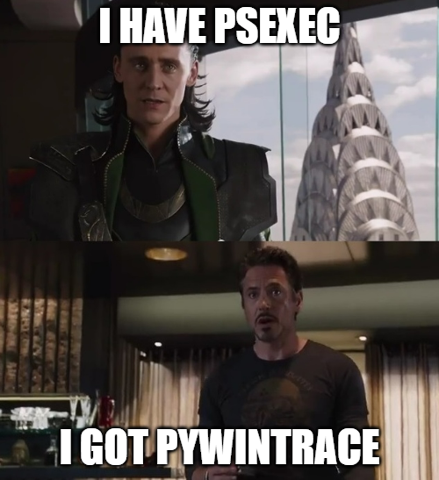
Demo Time
RPC Visibility VS PSExec
Notes:
let’s begin with a quick demo of this whole shebang.
We’ll use PSExec for it since it’s easy. How does PSExec work? First, it copies its service binary to the target machines ADMIN share, then launches it by communicating with the service manager over RPC to create a new service for it and starting it. With RPC Visibility, we can detect both the create and start requests.
BTW, just for giggles, I also implemented a rudimentary lateral tool transfer detection, using the SMB ETW again - we can detect a network create file and write operation, and cross the path with the filesystem. If it doesn’t exist and we’re looking at a binary or a suspicious path, it could be a sign for nefarious activity.
We don’t even need to rely on the SMB though. PSExec could be used to launch script files or binaries hosted remotely, which would not require any prior tool transfer. Since we detect the service creation and run events, we don’t care that much anyway.

Slide 80


PSExec
Both a general name for attack technique and a sysinternals tool
Copy service PE to remote machine’s ADMIN$ share
Tell the SCM (using MS-SCMR) to run a service from the copied binary
0xC — RCreateServiceW
SMB
cp psexesvc.exe \\VICTIM\ADMIN$\psexesvc.exe
2. RPC, MS-SCMR
RCreateServiceW(\\VICTIM, C:\Windows\psexesvc.exe)
Notes:
PsExec64 \\192.168.0.3 -u TEST-DOMAIN\administrator -p Aa1234567 -i cmd "/c msg * hax"
python rpc_visibility.py --db_host bolt://192.168.0.1:7687 --username neo4j --password Aa1234567

Slide 81
Detecting Lateral Tool Transfer
We’re already consuming file access events, just take the access flags from there
event 8 — Smb2RequestCreate_V2
<template tid="Smb2RequestCreateArgs_V2">
…
<data name="DesiredAccess" inType="win:Int32"/> … <data name="CreateDisposition" inType="win:Int32"/>
…
<data name="Filename" inType="win:UnicodeString"/>
…
</template>
Notes:
After PSExec demo

Slide 82
Detecting Lateral Tool Transfer
See if filename ends in an executable extension
Can also try to read the file to detect MZ
Request flags:
DesiredAccess: Write
CreationDisposition: Overwrite | Overwrite If | Create

Slide 83
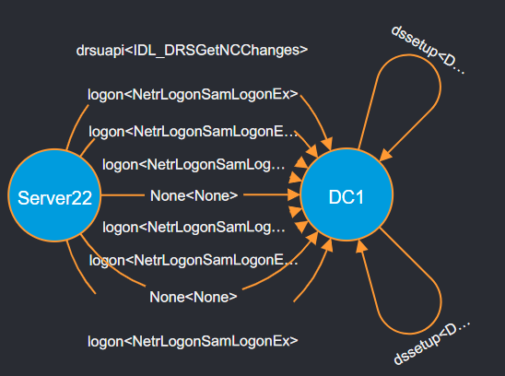
DCSync
Connect to a DC and pretend to be another DC
Request replication of the credential database
Uses the Directory Replication service (MS-DRSR)
0x3 — IDL_DRSGetNCChanges
Notes:
In DCSync, you pretend to be a DC, and contact the real DC asking to replicate the credential database. It uses the Directory Replication interface, specifically DRSGetNCChanges.
Since computers connect to the DC all the time, it might be tough to isolate the normal traffic from malicious one…

Slide 84

DCSync
Connect to a DC and pretend to be another DC
Request replication of the credential database
Uses the Directory Replication service (MS-DRSR)
0x3 — IDL_DRSGetNCChanges
Notes:
, unless we have RPC visibility

Slide 85
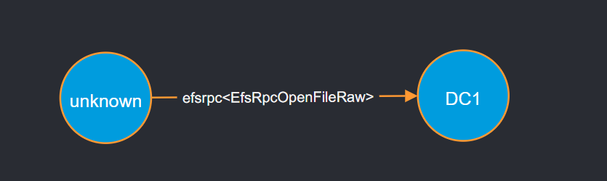
PetitPotam
Tell the EFS service to open a remote file
Triggers an SMB connection with authentication that can be relayed
Uses the MS-EFSR interface
0x0 — EfsRpcOpenFileRaw
0x4 — EfsRpcEncryptFileSrv
Notes:
PetitPotam reference: https://github.com/topotam/PetitPotam/blob/main/PetitPotam.py
PetitPotam is a coercion attack on the Encrypted File System service. Basically, you could tell it to open a file, provide it a UNC path, and it would trigger out an SMB connection with authentication, that you can then relay.
When it was released, it was using EfsRpcOpenFileRaw, but that was patched. Topotam (the researcher who found the vulnerability), also found that EfsRpcEncryptFileSrv has the same flaw.

Slide 86
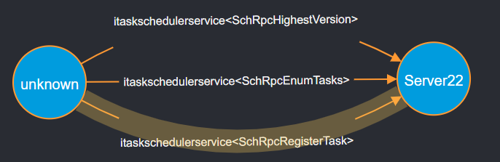

Task Scheduler
Create a scheduled task remotely
MITRE T1053.005
Uses the Task Scheduler Service Remoting protocol MS-TSCH
0x1 — SchRpcRegisterTask
Notes:
Similar to PSExec, we can remotely connect to the task scheduler, and tell it to create tasks or run them. There’s a lot of connections going on a single request from the task scheduler to the remote task scheduler, but we are looking into a single one - SchRpcRegisterTask .

Slide 87
Complications

Slide 88
#define DCOM
Distributed Component Object Model — extending COM over the network
COM — another IPC mechanism in Windows, extends process capabilities via objects
Objects implemented in DLLs
DLLs loaded into a host process or the calling process
Notable usage examples include WMI, MMC and ActiveX

Slide 89
Demo Time
So how does DCOM look like?
Notes:
runas /user:administrator@test-domain /netonly powershell
powershell.exe -Command {[System.Activator]::CreateInstance([type]::GetTypeFromProgID("MMC20.Application.1","192.168.0.3")).Document.ActiveView.ExecuteShellCommand("cmd",$null,"/c msg * hax","7")}

Slide 90
DCOM call flow
CreateObject
QueryInterface
Invoke
Release

Slide 91
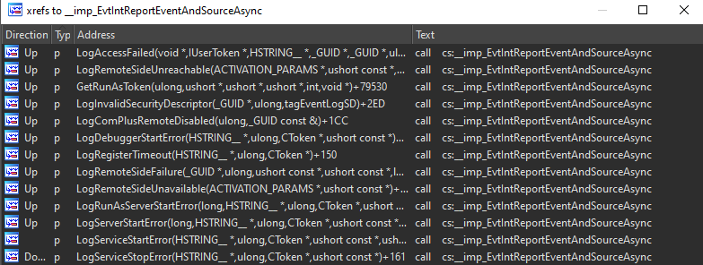
ETW isn’t always the solution 😢
The DCOM ETW provider is a lot less documented
From RE, it doesn’t appear as there are any call start events
Mostly error events, could still be useful for threat hunting, less for network flows
Notes:
After the WMIC slides

Slide 92
DCOM ETW Event 10001 - task_010001
<template tid="task_010001Args">
<data name="param1" inType="win:UnicodeString"/> <data name="param2" inType="win:UnicodeString"/> <data name="param3" inType="win:UnicodeString"/> <data name="param4" inType="win:UnicodeString"/> <data name="param5" inType="win:UnicodeString"/>
</template>

Slide 93
Context is the magic word
We can get some context on the requested operation from the process that handled it
The process is usually closed by the time we parse it
ETW to the rescue, once more - Microsoft-Windows-Kernel-Process
https://github.com/repnz/etw-providers-docs/blob/master/Manifests-Win10-17134/Microsoft-Windows-Kernel-Process.xml

Slide 94
Heuristics, with some extra sprinkled on top
A process by itself isn’t usually a strong indicator for investigation
A process that was involved in DCOM is a stronger indicator
Requires a strong baseline on what happens usually in the network
Can lead to FPs
Better than nothing
We can go even deeper with DLL matching
Requires even more fine tuning

Slide 95
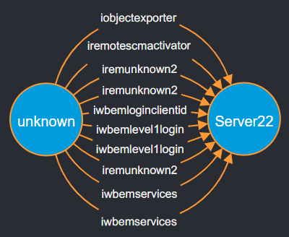
Remote WMI
WMI — Windows Management Instrumentation
Represent OS components in models
Allows querying and modifying parts of the OS
Win32_Process — process class in WMI
Also allows binary execution
Notes:
wmic /node:192.168.0.3 /user:"administrator@test-domain.research" /password:Aa1234567 process call create "cmd /c msg * hax"

Slide 96
Determining WMI maliciousness
Check the opnums in each malicious operation, compared to benign
Heuristic based approach, has to be configured for each technique
WMIC process get
WMIC process call create
Interface Name | Opnums
iwbemservices | 20
iremunknown2 | 5, 3
iwbemlevel1login | 6, 3
iwbemloginclientid | 3
iremotescmactivator | 4
iobjectexporter | 5
iwbemwcosmartenum | 3
iwbemfetchsmartenum | 3
Interface Name | Opnums
iwbemservices | 24, 6
iremunknown2 | 5, 3
iwbemlevel1login | 6, 3
iwbemloginclientid | 3
iremotescmactivator | 4
iobjectexporter | 5

Slide 97
Determining WMI maliciousness
Check the opnums in each malicious operation, compared to benign
Heuristic based approach, has to be configured for each technique
WMIC process get
WMIC process call create
Interface Name | Opnums
iwbemservices | 20
iremunknown2 | 5, 3
iwbemlevel1login | 6, 3
iwbemloginclientid | 3
iremotescmactivator | 4
iobjectexporter | 5
iwbemwcosmartenum | 3
iwbemfetchsmartenum | 3
Interface Name | Opnums
iwbemservices | 24, 6
iremunknown2 | 5, 3
iwbemlevel1login | 6, 3
iwbemloginclientid | 3
iremotescmactivator | 4
iobjectexporter | 5

Slide 98
Determining WMI maliciousness
Check the opnums in each malicious operation, compared to benign
Heuristic based approach, has to be configured for each technique
WMIC process get
WMIC process call create
Interface Name | Opnums
iwbemservices | ExecQuery
iwbemwcosmartenum | Next
iwbemfetchsmartenum | GetSmartEnum
Interface Name | Opnums
iwbemservices | ExecMethod
 | GetObject

Slide 99
Drawbacks
Still only metadata based detection
Can’t differentiate between “good” and “bad” flows
Detection has to be context dependent
Will have to be heuristics based analysis
Can’t handle DCOM with certainty
No blocking, visibility only
Notes:
So all those detections are nice and good, but they’re not perfect. We still don’t have view into the traffic itself, so it will always have to be a heuristic analysis approach.
Take PetitPotam for example. In environments where EFS is used extensively, we could be swamped with FPs since everyone and their mother are requesting file access.
So RPC Visibility is not a perfect solution, and would have to be adjusted according to the network itself.
Another drawback is that there’s no blocking, it’s a visibility only solution, which limits how you can use it to react to incidents.

Slide 100
Incident Response & Mitigation
Notes:
So what can you do?

Slide 101
#define RPC Filters
Filtering mechanism part of the Windows Firewall
Exposed through netsh or via WinAPI
Available since Windows Vista
netsh rpc filter>show filter
Listing all RPC Filters.
---------------------------------
filterKey: ac65a4a0-0ab9-11ee-b826-8038fb83bd95
displayData.name: RPCFilter
displayData.description: RPC Filter
filterId: 0x2e0773
layerKey: um
weight: Type: FWP_EMPTY Value: Empty
action.type: block
numFilterConditions: 1
filterCondition[0]
fieldKey: if_uuid
matchType: FWP_MATCH_EQUAL
conditionValue: Type: FWP_BYTE_ARRAY16_TYPE Value: 367abb81 35f19844 f09832ad 03100038
Notes:
Introducing the RPC filters. I know people like to diss on Windows Vista, but it did introduce some neat stuff.
RPC Filters are part of the Windows Firewall and can be used to create FW rules on RPC connections.
You can create/modify rules using netsh, or WinAPI. Here we can see an example of a filter I created in netsh.

Slide 102
Layers? Is it a cake?
Filtering can occur at different parts of the RPC connections
Pre-defined layers tell the FW where to apply the rule
FWPM_LAYER_RPC_UM — connection to interface
FWPM_LAYER_RPC_EPMAP — connection to the endpoint mapper
FWPM_LAYER_RPC_EP_ADD — new endpoint registration
Notes:
Filtering can occur at different stages of the connection, and choosing where is done using something called layers.
You can apply rules for connections to RPC interfaces directly, or you can put them earlier, on queries to the endpoint mapper or even during the registration of new endpoints

Slide 103
#define RPC Filters
Filtering mechanism part of the Windows Firewall
Exposed through netsh or via WinAPI
Available since Windows Vista
netsh rpc filter>show filter
Listing all RPC Filters.
---------------------------------
filterKey: ac65a4a0-0ab9-11ee-b826-8038fb83bd95
displayData.name: RPCFilter
displayData.description: RPC Filter
filterId: 0x2e0773
layerKey: um
weight: Type: FWP_EMPTY Value: Empty
action.type: block
numFilterConditions: 1
filterCondition[0]
fieldKey: if_uuid
matchType: FWP_MATCH_EQUAL
conditionValue: Type: FWP_BYTE_ARRAY16_TYPE Value: 367abb81 35f19844 f09832ad 03100038
Notes:
In the previous example of my rule, we can see I put it to filter on connections to the Windows event log, as indicated by the layer UM (user mode) and the interface uuid value

Slide 104
Filter fields
src & dst IP
RPC endpoints (port/named pipe)
RPC interface UUID
User token
. . .
Full list + notes in our GH
Notes:
In terms of what can you filter on, it’s just like a regular FW - IPs, endpoints
But there’s some more RPC like stuff in there as well, such as the RPC interface, user token and more.
The filter keys are documented in MSDN to some extent, but we have a list on our GH with additional notes and examples.

Slide 105
Mitigation strategies
After understanding what RPC traffic is going on in the network (using ETW), we can:
Notes:
Ok so we know what RPC filters are, what are they useful for?
And there’s a few synergies here with RPC Visbility
If you see that there’s no traffic on a potentially bad interface, then why not block it? Or allow it only from the legitimate place, and block the rest. If we look at PSExec and SCMR for example, you normally won’t see network traffic for it. At most you can expect some monitoring servers or watchdogs to access it remotely. In that case, why not work on restricting it with filters, to block PSExec attacks pre-emptively.
Or if you’re already dealing with a breach, you can use it as a shutdown button
Or restrict a compromised user using the filters
There are many options for defense and reaction, and I’m other researchers and network defenders can come with even better strategies than those I raised here.

Slide 106
Mitigation strategies
After understanding what RPC traffic is going on in the network (using ETW), we can:
Block unused RPC interfaces that can be used by attackers
If no one is using SCMR, why should it be left open?
Notes:
Ok so we know what RPC filters are, what are they useful for?
And there’s a few synergies here with RPC Visbility
If you see that there’s no traffic on a potentially bad interface, then why not block it? Or allow it only from the legitimate place, and block the rest. If we look at PSExec and SCMR for example, you normally won’t see network traffic for it. At most you can expect some monitoring servers or watchdogs to access it remotely. In that case, why not work on restricting it with filters, to block PSExec attacks pre-emptively.
Or if you’re already dealing with a breach, you can use it as a shutdown button
Or restrict a compromised user using the filters
There are many options for defense and reaction, and I’m other researchers and network defenders can come with even better strategies than those I raised here.

Slide 107
Mitigation strategies
After understanding what RPC traffic is going on in the network (using ETW), we can:
Block unused RPC interfaces that can be used by attackers
If no one is using SCMR, why should it be left open?
Block RPC interfaces once an attack is detected/suspected
Emergency anti-lateral movement button
Notes:
Ok so we know what RPC filters are, what are they useful for?
And there’s a few synergies here with RPC Visbility
If you see that there’s no traffic on a potentially bad interface, then why not block it? Or allow it only from the legitimate place, and block the rest. If we look at PSExec and SCMR for example, you normally won’t see network traffic for it. At most you can expect some monitoring servers or watchdogs to access it remotely. In that case, why not work on restricting it with filters, to block PSExec attacks pre-emptively.
Or if you’re already dealing with a breach, you can use it as a shutdown button
Or restrict a compromised user using the filters
There are many options for defense and reaction, and I’m other researchers and network defenders can come with even better strategies than those I raised here.

Slide 108
Mitigation strategies
After understanding what RPC traffic is going on in the network (using ETW), we can:
Block unused RPC interfaces that can be used by attackers
If no one is using SCMR, why should it be left open?
Block RPC interfaces once an attack is detected/suspected
Emergency anti-lateral movement button
Restrict compromised users using RPC filters
Notes:
Ok so we know what RPC filters are, what are they useful for?
And there’s a few synergies here with RPC Visbility
If you see that there’s no traffic on a potentially bad interface, then why not block it? Or allow it only from the legitimate place, and block the rest. If we look at PSExec and SCMR for example, you normally won’t see network traffic for it. At most you can expect some monitoring servers or watchdogs to access it remotely. In that case, why not work on restricting it with filters, to block PSExec attacks pre-emptively.
Or if you’re already dealing with a breach, you can use it as a shutdown button
Or restrict a compromised user using the filters
There are many options for defense and reaction, and I’m other researchers and network defenders can come with even better strategies than those I raised here.

Slide 109
Summary
The RPC ETW provider is a treasure trove of information
Use it to to get the gist of what is going on in the network, and detect potential malicious activity
Respond to incidents with RPC filters, or use them to mitigate the risk beforehand
Notes:
And that’s it. Let’s summarize shall we:

Slide 110
Thanks for listening
Questions?

Slide 111

References
Our repository for all things RPC, including the RPC Visibility script
RPC tools by other researchers
RpcMon by CyberArk
RpcInvestigator by TrailOfBits
RPC Firewall, requires process injection & hooks
A Definitive Guide to the RPC filters, by our research team
Useful readings:
Jonathan Johnson of SpecterOps, Utilizing RPC Telemetry
Carsten Sandker, Offensive Windows IPC Internals 2: RPC
James Forshaw, How to secure a Windows RPC Server, and how not to.

